Slide 1
Springboard Capstone project USA Time series predictions

Slide 2
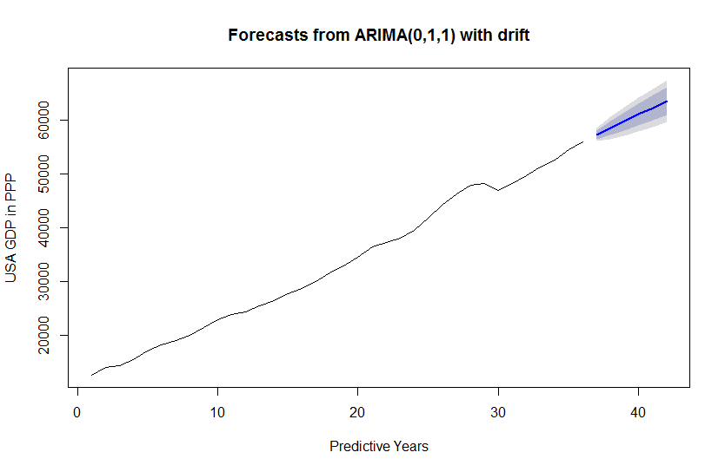
USA GDP In PPP
This is the forecast of how much the USA GDP will grow over the next six years.

Slide 3
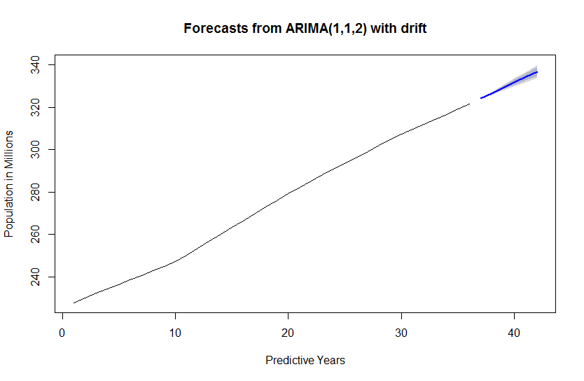
USA population in millions
This is the forecast of the population of the USA over the next six years.

Slide 4
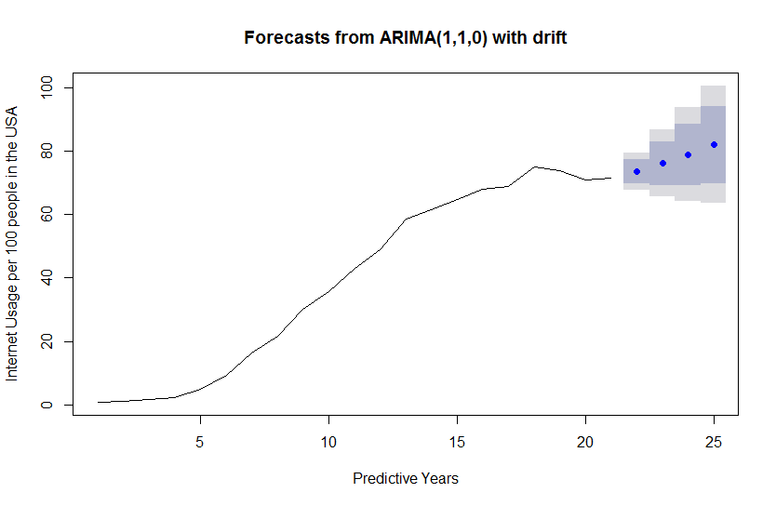
Internet usage per 100 people
This is the chart for my predictions of what the internet usage would have been like from 2011 to 2014

Slide 5
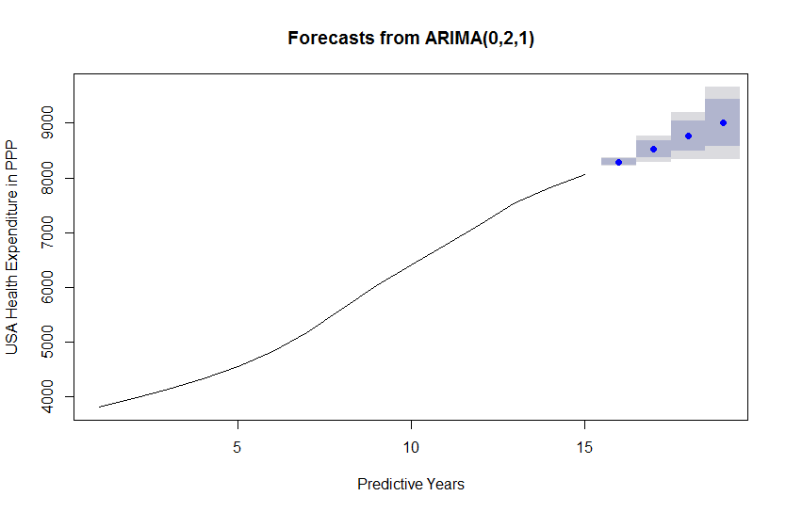
USA Health expenditure in PPP
This is the chart for my predictions of what USA health expenditure would have been like from 2011 to 2014

Slide 6
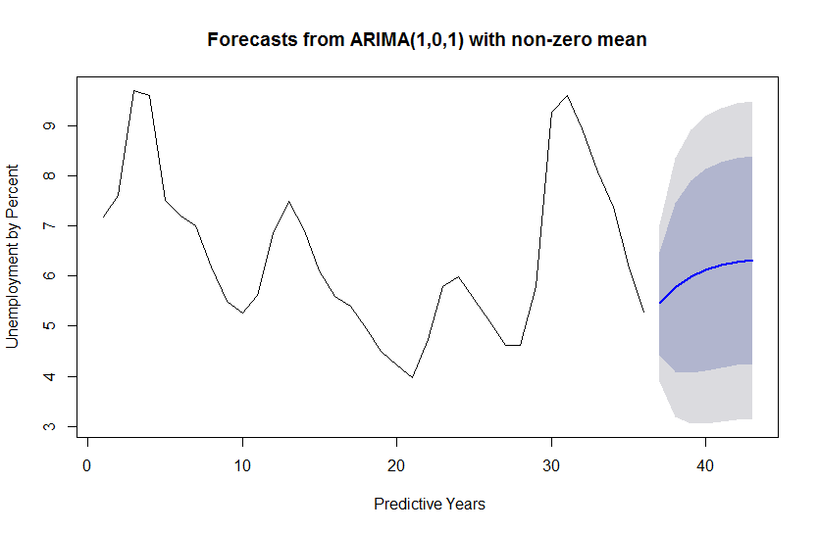
USA Unemployment rate in percentages
This is my forecast of what the next six years will look like for unemployment rates in the USA

Slide 7
Conclusion and final remarks
I believe that the best indicators for this sort of analysis is those data that came from the IMF database since they had more data points and they also had predictions for the future whereas the World Bank Database did not seem to have as many data points and therefore seemed harder to predict. It was also interesting to see how the graphs for the IMF data seemed more consistent.

Slide 8
My predictions show that for the most part that everything is increasing which would make sense given that if the population increases we would have a higher GDP, internet usage and health care expenditure. The thing that surprised me was to see that the IMF data had unemployment decreasing for the most part, whereas my predictions showed the opposite and unemployment was going to steadily increase. With this knowledge the government could be on the look out for warning signs of unemployment increase and find a way to increase employment opportunities and maybe help people learn a trade or get educated so they could get a better job.

